Slide 1
Project-Build1

Slide 2
Concordia University
Department of Computer Science and Software Engineering
Advanced Programming Practices
SOEN 6441 --- Winter 2024
Professor: Joey Paquet
Students: Team 14
Mahdieh Shekarian-40279366
Parsa MohammadRezaei-40277489
AmirMohammad RezaeiPour-40279239
Farid Farahman-40241630
Mohammad Aminan-40277902
Omer Sayem-40226505

Slide 3
Agenda
Diagram
Code Explanation
Code
Model
Player
Continent
Country
Game State
Order
Controller
Command
Country Controller
Map Controller
Order Controller
Player Controller
Services
App
Game Engine
Game Menu
Test
Models
Game State Test
Controllers
Country Controller Test
Player Controller Test
Services
Game Graph Utils Test
Pictures

Slide 4
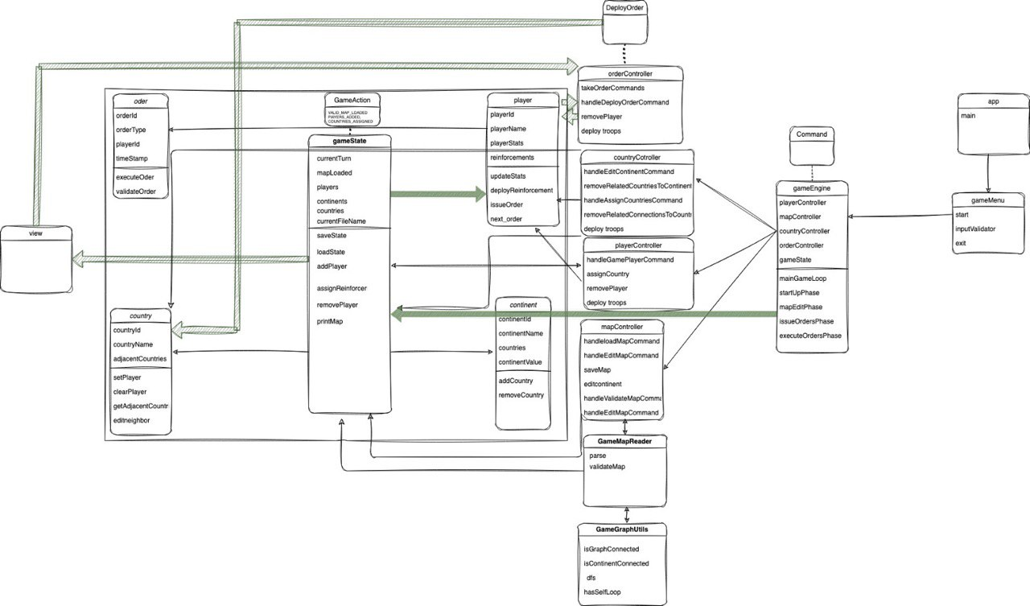

Slide 5
Code Explanation
Our code uses the MVC architecture and has Model,
Controllers, and Services.
In the following, each of them will be going to explained.

Slide 6
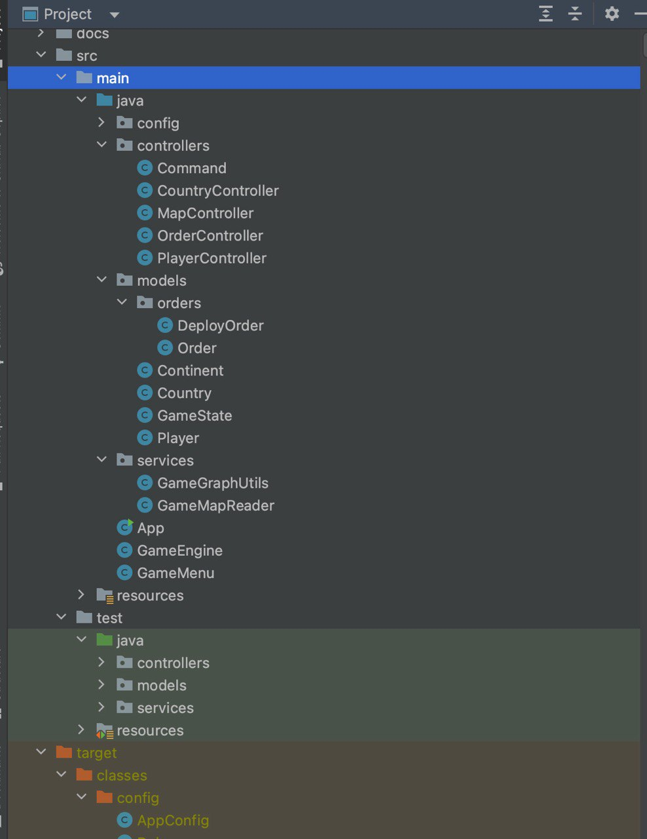
Project Structure

Slide 7
Code

Slide 8
Model
There are five classes in the Model:
1- Player
2- Continent
3- Country
4- Game State
5- Order :Order , Deploy Order

Slide 9
Player
The Player class represents a player in a game, with their name, statistics,
reinforcements, orders, and the countries they control.
The class provides methods for issuing and executing orders, managing
reinforcements, and accessing player information.

Slide 10
Player (cont.)
Instance Variables:
d_totalPlayers: This is a static variable that keeps track of the total number of players. It is declared as private and static, meaning it is shared among all instances of the Player class.
d_name: This variable stores the name of the player. It is declared as a String.
d_playerStat: This variable represents the player's statistics. Its purpose and data type are not specified in the provided code.
d_reinforcement: This variable stores the number of reinforcements available to the player.
d_reinforcementPoll: This variable represents the number of reinforcements the player can allocate during a specific phase.
d_orders: This is a queue data structure that stores the orders issued by the player. The type of orders stored in the queue is Order, which is an abstract class or interface in the code.
d_countries: This is an ArrayList that stores the countries controlled by the player. The type of objects stored in the ArrayList is Country.

Slide 11
Player (cont.)
Constructors:
Player(): This is a default constructor with no parameters. It does not initialize any instance variables.
Player(String p_name): This constructor takes a player name as a parameter and initializes the instance variables d_name, d_countries, d_orders, d_reinforcement, and d_reinforcementPoll with appropriate values.
Methods:
issueOrder(): This method is called during the "issue orders" phase of the game. It uses a while loop to continuously take orders using the OrderController.takeOrderCommands() method, validates the order using OrderController.validateOrder(), and adds the valid order to the d_orders queue. If the order is an instance of DeployOrder, it also reduces the d_reinforcementPoll by the number of reinforcements specified in the order.
nextOrder(): This method is called during the "execute orders" phase of the game. It retrieves and removes the first order from the d_orders queue using the poll() method and returns it.
Getters and Setters: These methods provide access to the private instance variables of the Player class.

Slide 12
Player (cont.)
Other Helper Methods:
getBaseReinforcement(): This method calculates and returns the base number of reinforcements a player receives. It is determined based on the number of countries the player controls.
getCountryIds(): This method returns an ArrayList of integers representing the IDs of the countries controlled by the player.
addCountry(Country p_country): This method adds a Country object to the d_countries ArrayList.
removeAllCountries(): This method removes all countries from the d_countries ArrayList.
toString(): This method overrides the default toString() method and returns a string representation of the Player object.

Slide 13
Continent
The Continent class is a simple representation of a continent in a game.
It stores information such as the continent's ID, name, value, and color.
The class provides constructors to initialize the continent object with different combinations of values and getter/setter methods to access and modify the instance variables.

Slide 14
Continent (cont.)
Instance Variables:
d_id: This variable stores the ID of the continent.
d_value: This variable represents the value or bonus associated with the continent.
d_name: This variable stores the name of the continent.
d_color: This variable stores the color associated with the continent.
Constructors:
Continent(int p_continentId, String p_continentName, int p_continentValue, String p_color): This constructor takes the continent's ID, name, value, and color as parameters and initializes the corresponding instance variables with the provided values.
Continent(int p_continentId, int p_continentValue): This constructor takes the continent's ID and value as parameters. It initializes the d_id with the provided ID, sets the d_name as a string representation of the ID, and sets the d_value with the provided value. The d_color is set to "N/A" (not available) by default.

Slide 15
Continent (cont.)
Methods :
Getters and Setters: These methods provide access to the private instance variables of the Continent class.
Other Helper Methods :
toString(): This method overrides the default toString() method and returns a string representation of the Continent object. It includes the ID and value of the continent.

Slide 16
Country
The Country class is used to represent countries in a game.
It stores information such as the country's ID, name, adjacent countries, continent ID, and the number of reinforcements.
The class provides constructors to initialize the country object with different combinations of values, getter/setter methods to access and modify the instance variables, and methods to add and remove adjacent countries.

Slide 17
Country (cont.)
Instance Variables:
d_countryId: This variable stores the ID of the country.
d_countryName: This variable stores the name of the country.
d_adjacentCountries: This is a List of integers that represents the IDs of the countries adjacent to the current country.
d_continentId: This variable stores the ID of the continent to which the country belongs.
numberOfReinforcements: This variable represents the number of reinforcements currently present in the country.
Constructors:
Country(int p_countryId, String p_countryName, int p_continentId): This constructor takes the country's ID, name, and continent ID as parameters. It initializes the corresponding instance variables with the provided values and initializes an empty ArrayList for d_adjacentCountries. The numberOfReinforcements is set to 0 by default.
Country(int p_countryId, String p_countryName, int p_continentId, List<Integer> p_adjacentCountries): This constructor takes the country's ID, name, continent ID, and a List of adjacent country IDs as parameters. It initializes the corresponding instance variables with the provided values.

Slide 18
Country (cont.)
Methods :
Getters and Setters: These methods provide access to the private instance variables of the Country class.
addAdjacentCountry(int p_adjacentCountryId): This method adds an adjacent country ID to the d_adjacentCountries list.
removeAdjacentCountry(int p_adjacentCountryId): This method removes an adjacent country ID from the d_adjacentCountries list and returns true if the removal was successful.
setPlayer(): This method is empty and does not have any functionality specified.
clearPlayer(): This method is empty and does not have any functionality specified.
editNeighbor(): This method is empty and does not have any functionality specified.
Other Helper Methods :
toString(): This method overrides the default toString() method and returns a string representation of the Country object. It includes the country's ID, name, and continent ID.

Slide 19
Game State
The GameState class is responsible for managing the state of the game.
It keeps track of the current turn, whether a map has been loaded, the players, continents, and countries in the game.
It provides methods to perform actions such as adding players, setting the map loaded status,
advancing the turn, and printing the map details. It also includes methods for calculating and assigning
reinforcements to players based on continent ownership.

Slide 20
Game State (cont.)
Instance Variables:
d_id: This variable stores the ID of the continent.
d_value: This variable represents the value or bonus associated with the continent.
d_name: This variable stores the name of the continent.
d_color: This variable stores the color associated with the continent.
Constructors:
Continent(int p_continentId, String p_continentName, int p_continentValue, String p_color): This constructor takes the continent's ID, name, value, and color as parameters and initializes the corresponding instance variables with the provided values.
Continent(int p_continentId, int p_continentValue): This constructor takes the continent's ID and value as parameters. It initializes the d_id with the provided ID, sets the d_name as a string representation of the ID, and sets the d_value with the provided value. The d_color is set to "N/A" (not available) by default.

Slide 21
Game State (cont.)
Methods :
setActionDone(GameAction action): This method adds a game action to the gameStateFlags set, indicating that the action has been performed.
isActionDone(GameAction action): This method checks if a specific game action has been performed.
removeAction(GameAction action): This method removes a game action from the gameStateFlags set.
GameState(): This is the constructor for the GameState class. It initializes the players, continents, and countries maps, and sets the currentFileName to an empty string.
Enum:
GameAction: This enum represents various game actions and is used as flags to keep track of the game state.

Slide 22
Game State (cont.)
Getter and Setter Methods :
getCurrentFileName(), setCurrentFileName(String p_currentFileName): These methods get and set the currentFileName variable.
isMapLoaded(), setMapLoaded(boolean p_mapLoaded): These methods get and set the mapLoaded variable.
getContinents(), setContinents(Map<Integer, Continent> p_continents): These methods get and set the continents map.
getCountries(), setCountries(Map<Integer, Country> p_countries): These methods get and set the countries map.
getCurrentTurn(): This method returns the current turn number.
getPlayers(): This method returns the players map.

Slide 23
Game State (cont.)
Other Methods:
showMap(): This method is empty and does not have any functionality specified.
printMap(): This method prints the continents and their details, as well as the countries and their adjacency information.
assignReinforcements(): This method calculates and assigns reinforcements to each player based on the number of continents they own. It also prints the number of reinforcements for each player.
getPlayerOwnedContinents(Player p_player): This method returns a list of continent IDs owned by the given player.
getCountryIDsInsideContinent(int p_continentID): This method returns a list of country IDs that are inside the given continent.

Slide 24
Order
The Order class is a base class for defining different types of orders in a game.
It provides common functionality such as storing the owner of the order and validating the order.
Each specific order type would extend this class and implement its own execute() method to define the behavior of that specific order.

Slide 25
Order (cont.)
Instance Variables:
d_orderId: This variable stores the ID of the order.
d_owner: This variable represents the owner of the order and is of type Player.
Constructors:
Order(Player p_owner): This constructor initializes the d_owner variable with the provided p_owner parameter.
Order(): This is an empty constructor.
Methods:
execute(): This method is empty and does not have any functionality specified. It is intended to be overridden in subclasses.
getOrderID(): This method returns the ID of the order.
getOwnerPlayer(): This method returns the Player object representing the owner of the order.
validate(): This method returns a boolean value indicating whether the order is valid. It is intended to be overridden in subclasses.

Slide 26
Deploy Order
The DeployOrder class represents a specific type of order where reinforcements are deployed to a country owned by a player.
It extends the base Order class and provides its own implementation of the execute() and toString() methods.

Slide 27
Deploy Order (cont.)
Instance Variables:
d_countryId: This variable stores the ID of the country where the reinforcements will be deployed.
d_numReinforcements: This variable stores the number of reinforcements to be deployed.
Constructors:
DeployOrder(Player p_owner, int p_countryId, int p_numReinforcements): This constructor initializes the d_owner, d_countryId, and d_numReinforcements variables with the provided parameters. It uses the super keyword to call the constructor of the base class Order and pass the p_owner parameter.
Methods:
getCountryId(): This method returns the ID of the country where the reinforcements will be deployed.
getNumReinforcements(): This method returns the number of reinforcements to be deployed.
execute(): This method overrides the execute() method of the base class. It iterates over the countries owned by the order's owner (d_owner) and finds the country with the matching d_countryId. It then increases the number of reinforcements in that country by d_numReinforcements.
toString(): This method overrides the toString() method of the base class. It returns a string representation of the DeployOrder object, including the owner, country ID, and number of reinforcements.

Slide 28
Controller
There are five classes in the Controller:
1- Command
2- Country Controller
3- Map Controller
4- Order Controller
5- Play Controller

Slide 29
Command
The Command class provides a centralized place to define and access the commands and
their corresponding syntax in the game.
It can be used by other classes or components to validate and parse user input, execute specific actions based on the commands, and provide feedback or error messages to the user.

Slide 30
Command (cont.)
No-argument commands:
SHOW_MAP: Represents the command to show the map.
VALIDATE_MAP: Represents the command to validate the map.
ASSIGN_COUNTRIES: Represents the command to assign countries.
Argument commands:
EDIT_CONTINENT: Represents the command to edit continents.
EDIT_COUNTRY: Represents the command to edit countries.
EDIT_NEIGHBOR: Represents the command to edit neighbors.
Other commands:
SAVE_MAP: Represents the command to save the map.
EDIT_MAP: Represents the command to edit the map.
LOAD_MAP: Represents the command to load a map.

Slide 31
Command (cont.)
Gameplay-related commands:
GAME_PLAYER: Represents the command to manage players in the game.
DEPLOY: Represents the command to deploy reinforcements.
Options :
ADD: Represents the option to add something.
REMOVE: Represents the option to remove something.
Command syntax:
The class includes string constants that define the syntax for each command.

Slide 32
Country Controller
This class is responsible for handling commands related to countries, such as assigning countries to players and editing country details.
This code provides functionality for assigning countries to players and editing the game map by adding or removing countries, continents, and connections between countries.

Slide 33
Country Controller (cont.)
The CountryController class has a reference to the GameState class, which represents the current state of the game.
The handleAssignCountriesCommand method is used to assign countries to players. It checks if the necessary conditions are met, such as the presence of players and a valid map. It then assigns countries randomly to players and updates the game state accordingly.
The handleEditNeighborCommand method is used to add or remove connections (neighbors) between countries. It takes the country IDs as arguments and performs the corresponding operation based on the provided command.
The handleEditCountryCommand method is used to add or remove countries from the game. It takes the country ID and, optionally, the continent ID as arguments. It performs the specified operation based on the provided command.
The handleEditContinentCommand method is used to add or remove continents from the game. It takes the continent ID and, optionally, the bonus value as arguments. It performs the specified operation based on the provided command.
The removeRelatedCountriesToContinent method is a helper method that removes countries associated with a continent. It also calls the removeRelatedConnectionsToCountry method to remove connections to the removed countries.
The removeRelatedConnectionsToCountry method is another helper method that removes connections to a specific country.

Slide 34
Map Controller
The MapController class is responsible for handling the map parsing, validation, and display
of continents and countries from a game map file. It utilizes the GameMapReader service to
read and validate the map file.

Slide 35
Map Controller (cont.)
Constructor: There are three overloaded constructors that initialize the MapController object with a GameState object and/or a file path.
getFilePath(): Returns the file path of the map file.
handleShowMapCommand(String[] p_args): Handles the command to show the map. It checks the number of arguments and calls the showMap() method of the GameState object.
handleValidateMapCommand(String[] p_args): Handles the command to validate the map. It checks the number of arguments and calls the validateMap() method of the GameMapReader object. If the map is valid, it prints a success message; otherwise, it throws an exception.
handleEditMapCommand(String[] p_args): Handles the command to edit the map. It checks the number of arguments and determines whether to load an existing map or create a new one based on the file's existence. If the file exists, it sets the file path and calls the loadMap() method; otherwise, it creates a new map file. It updates the GameState object accordingly.

Slide 36
Map Controller (cont.)
saveMap(): Saves the map to a file. It validates the map using the validateMap() method of the GameMapReader object. If the map is valid, it writes the continents, countries, and borders to the file using a BufferedWriter.
createNewMap(String p_filePath): Creates a new map file at the specified file path.
loadMap(): Loads the game map file and validates it. It calls the parse() method of the GameMapReader object with the file path and returns the result of the validateMap() method.
handleLoadMapCommand(String[] p_args): Handles the command to load a map. It checks the number of arguments, verifies the existence of the file, and calls the parse() method of the GameMapReader object. If the map is valid, it updates the GameState object with the current file name.
printCountries(): Prints the countries and their details, including the country ID, name, adjacent countries, and continent ID.

Slide 37
Order Controller
The OrderController class is responsible for handling player orders in a game.
It provides methods to take order commands from the player, handle deploy order commands, validate orders, and validate deploy orders.

Slide 38
Order Controller (cont.)
Constructor: Initializes the OrderController object with a GameState object and a Scanner object.
takeOrderCommands(Player p_ownerPlayer): Takes order commands from the player and returns an Order object. It prompts the player for input, reads the command and arguments, and handles the command accordingly. If the command is "exit," it exits the game. If the command is "deploy," it calls the handleDeployOrderCommand() method to create a DeployOrder object. If the command is invalid, it displays an error message. The method continues to prompt for input until a valid command is entered.
handleDeployOrderCommand(String[] args, Player p_ownerPlayer): Handles the "deploy" order command and creates a DeployOrder object. It validates the number of arguments, parses the country ID and number of reinforcements from the command, and checks if the player owns the specified country. If the command is valid, it returns a DeployOrder object with the player, country ID, and number of reinforcements. If the command is invalid, it displays an error message and returns null.
validateOrder(Order p_order): Validates an Order object. It takes an Order as input and checks if it is an instance of DeployOrder. If it is, it calls the validateDeployOrder() method. If the order is invalid, it displays an error message and returns false. Otherwise, it returns true.
validateDeployOrder(DeployOrder p_order): Validates a DeployOrder object. It takes a DeployOrder as input and checks if the player has enough reinforcements and owns the specified country. If the order is invalid, it throws an exception with an appropriate error message.

Slide 39
Player Controller
The PlayerController class is responsible for handling player-related commands in a game,
such as adding and removing players from the game.

Slide 40
Player Controller (cont.)
Constructor: Initializes the PlayerController object with a GameState object.
handleGamePlayerCommand(String[] p_args): Handles the player add and remove commands. It takes an array of command arguments as input. The method checks the number of arguments and the command option (add or remove). If the command is "add," it creates a new Player object with the specified name, adds it to the players map in the GameState object, and logs a debug message. If the command is "remove," it checks if the specified player exists in the players map and removes it if found. If the players map becomes empty after removing a player, it removes the "PLAYERS_ADDED" action from the GameState. If any errors occur during command execution, an error message is displayed.

Slide 41
Services
There are three classes in the Service:
1- App
2- Game Engine
3- Game Menu

Slide 42
App
The App class represents the entry point of the application.
It sets up the application configuration, logs debug information, and starts the game menu.
Setting up application configuration:
It calls the setDebugMode and setVerboseMode methods of the AppConfig class to enable debug mode and verbose mode
for the application.
Logging debug information:
It uses the Debug.log method to log debug messages. It logs that the game has started and displays the status of the
verbose mode and debug mode based on the values set in the AppConfig class.
Starting the game menu:
It creates an instance of the GameMenu class and calls its start method to begin the game.
The App class assumes the existence of the AppConfig and Debug classes, which provide configurations and logging
capabilities, respectively.

Slide 43
Game Engine
The GameEngine class is responsible for handling the game loop and game phases.
It utilizes various controllers (PlayerController, MapController, CountryController, and
OrderController) to handle different aspects of the game.
The code assumes the existence of various classes such as Command, GameState, Player, Order, PlayerController, MapController, CountryController, and OrderController.
It also assumes the availability of logging capabilities through the Debug class.

Slide 44
Game Engine(cont.)
Constructor: Initializes the GameEngine object with a GameState object and a Scanner object.
mainGameLoop(): Represents the main game loop. It continues until the user has loaded a valid map, added players, and assigned countries. It calls the startUpPhase(), issueOrdersPhase(), and executeOrdersPhase() methods.
startUpPhase(): Represents the startup phase of the game. It displays the available commands and prompts the user for input. It handles commands such as adding players, loading and editing the map, and assigning countries. It continues until the user enters the "proceed" command or exits the game.
mapEditPhase(): Represents the map edit phase of the game. It displays the available commands and prompts the user for input. It handles commands related to editing the map, such as editing continents, countries, and neighbors, validating the map, saving the map, and showing the map. It continues until the user enters the "proceed" command or exits the game.
issueOrdersPhase(): Represents the issue orders phase of the game. It handles the issuing of orders by players. It prompts each player to issue orders until all players have finished issuing orders. It uses a map playerFinishedOrders to keep track of players who have finished issuing orders.
executeOrdersPhase(): Represents the execute orders phase of the game. It executes the orders issued by players in the previous phase. It iterates over each player and executes their next order until all orders have been executed. It also prints the players, their countries, and the number of reinforcements in each country.

Slide 45
Game Menu
It handles the game menu and starts the game.
The GameMenu class provides a simple game menu interface for starting the game or exiting the program based on user input.
The class has a private Scanner object called l_scanner, which is used to read user input.
The start() method is the entry point of the game. It displays the game menu and waits for user input.
Inside the while loop, the user's input is read and stored in the l_inputString variable. It is trimmed and converted to lowercase for case-insensitive comparison.
If the input is "start", the game is started. It creates a new instance of the GameEngine class, passing a new GameState object and the scanner object. Then it calls the mainGameLoop() method of the GameEngine to start the game.
If the input is "exit", the program exits the loop and terminates.
If the input is neither "start" nor "exit", an error message is displayed, and the loop continues to prompt for input.

Slide 46
Test

Slide 47
Model
There are one class in the Model:
1- Game State Test

Slide 48
Game State Test
The reinforcementBounsTest() method tests the assignReinforcements() method of the GameState class. It verifies that the correct number of reinforcements is assigned to each player.
The getPlayerOwnedContinentsTest() method tests the getPlayerOwnedContinents() method of the GameState class. It checks if the correct continents are returned for each player.
The getCountryIDsInsideContinentTest() method tests the getCountryIDsInsideContinent() method of the GameState class. It verifies that the correct country IDs are returned for each continent.

Slide 49
Controller
There are two classes in the Controller:
1- Country Controller Test
2- Player Controller Test

Slide 50
Country Controller Test
The assignedCountryShouldDeferByOneTest() method tests the handleAssignCountriesCommand() method of the CountryController class. It checks if the number of assigned countries for each player differs by at most one.
The shouldNotAddCountryToNonExistingContinent() method tests the handleEditCountryCommand() method of the CountryController class when trying to add a country to a non-existing continent. It verifies that the country is not added to the countries map.
The removeContinentTest() method tests the handleEditContinentCommand() method of the CountryController class when removing a continent. It checks if the continent is removed from the continents map.
The shouldRemoveRelatedCountriesWhenContinentRemoved() method tests the handleEditContinentCommand() method of the CountryController class when removing a continent. It verifies that the countries related to the removed continent are also removed from the countries map.
The shouldRemoveRelatedConnectionsWhenCountryRemoved() method tests the handleEditCountryCommand() method of the CountryController class when removing a country. It checks if the connections to the removed country are removed from the adjacentCountries list of other countries in the countries map.

Slide 51
Player Controller Test
The shouldNotAddMultiplePlayer() method tests the handleGamePlayerCommand() method of the PlayerController class when trying to add a player that already exists. It checks if the number of players remains the same.
The shouldNotRemoveNonExistentPlayer() method tests the handleGamePlayerCommand() method of the PlayerController class when trying to remove a player that does not exist. It does not perform any assertions.
The shouldRemovePlayerCorrectly() method tests the handleGamePlayerCommand() method of the PlayerController class when removing a player. It verifies that the player is removed from the players map.

Slide 52
Services
There are one class in the Services:
1- Game Graph Utils Test

Slide 53
Game Graph Utils Test
The class contains three test methods: testIsGraphConnected(), testIsContinentConnected(), and testSelfLoop().
The testIsGraphConnected() method tests the isGraphConnected() method of the GameGraphUtils class. It sets up a connected graph and asserts that the graph is connected. Then, it sets up a disconnected graph and asserts that the graph is not connected.
The testIsContinentConnected() method tests the isContinentConnected() method of the GameGraphUtils class. It sets up a connected graph representing a continent and asserts that the continent is a connected subgraph. Then, it sets up a disconnected continent and asserts that the continent is not a connected subgraph.
The testSelfLoop() method tests the hasSelfLoop() method of the GameGraphUtils class. It sets up a graph with a self-loop and asserts that the graph has a self-loop.

Slide 54
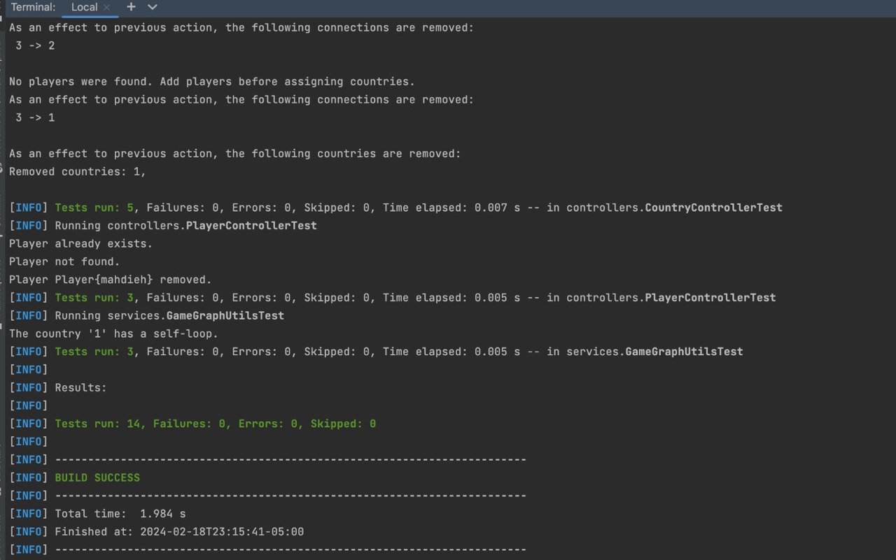

Slide 55
Git Hub Pictures

Slide 56
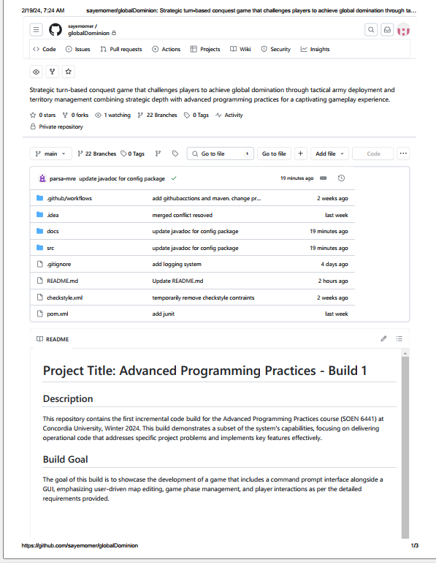
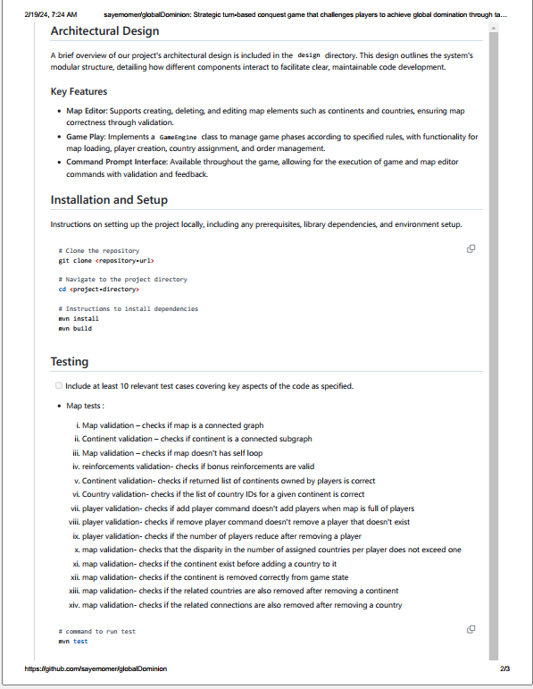

Slide 57
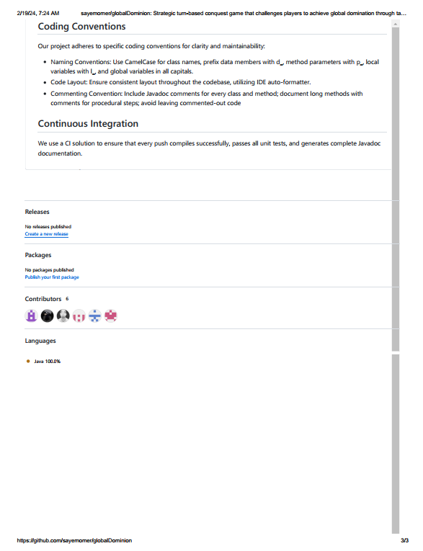
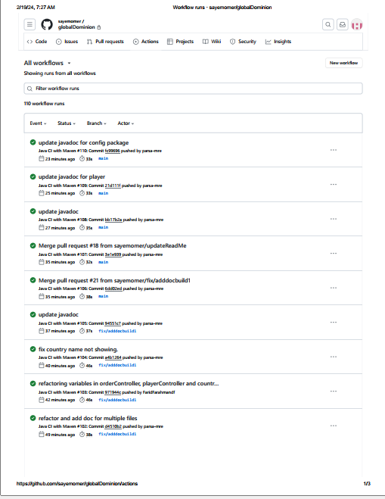

Slide 58
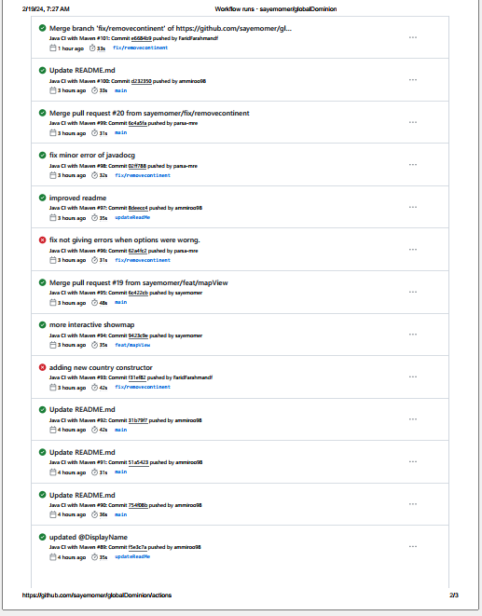
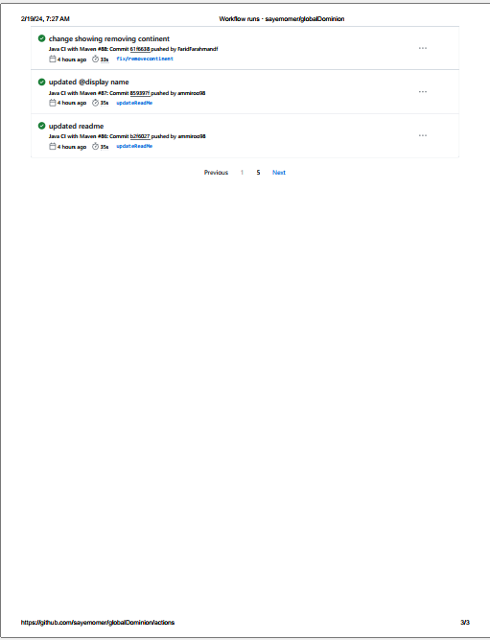

Slide 59
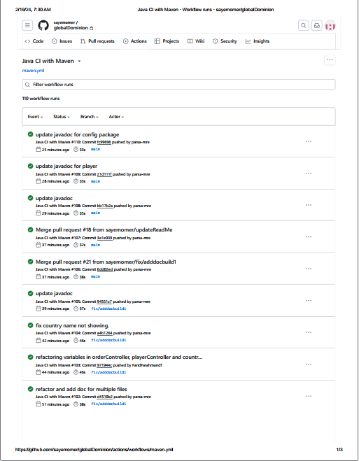
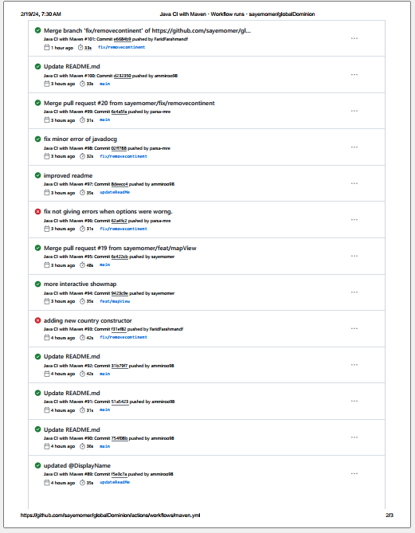

Slide 60
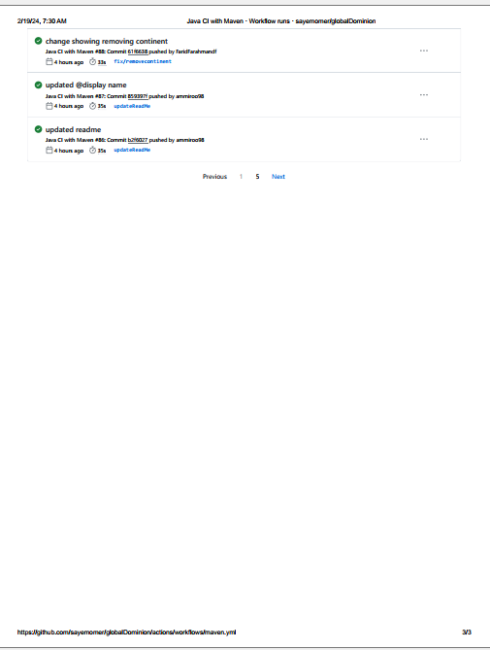
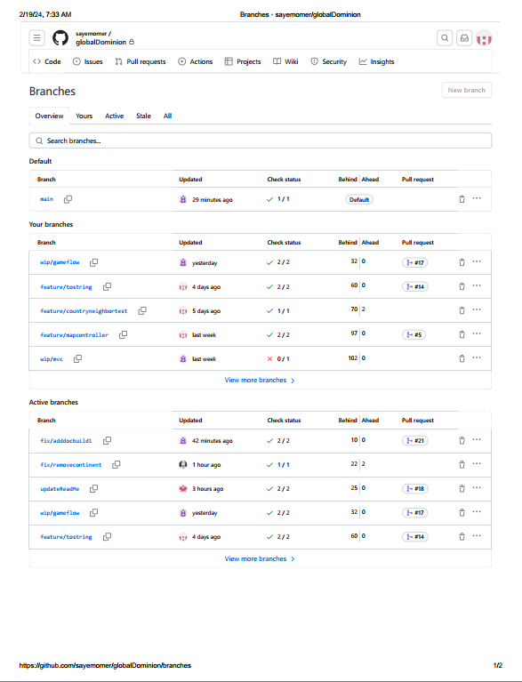

Slide 61
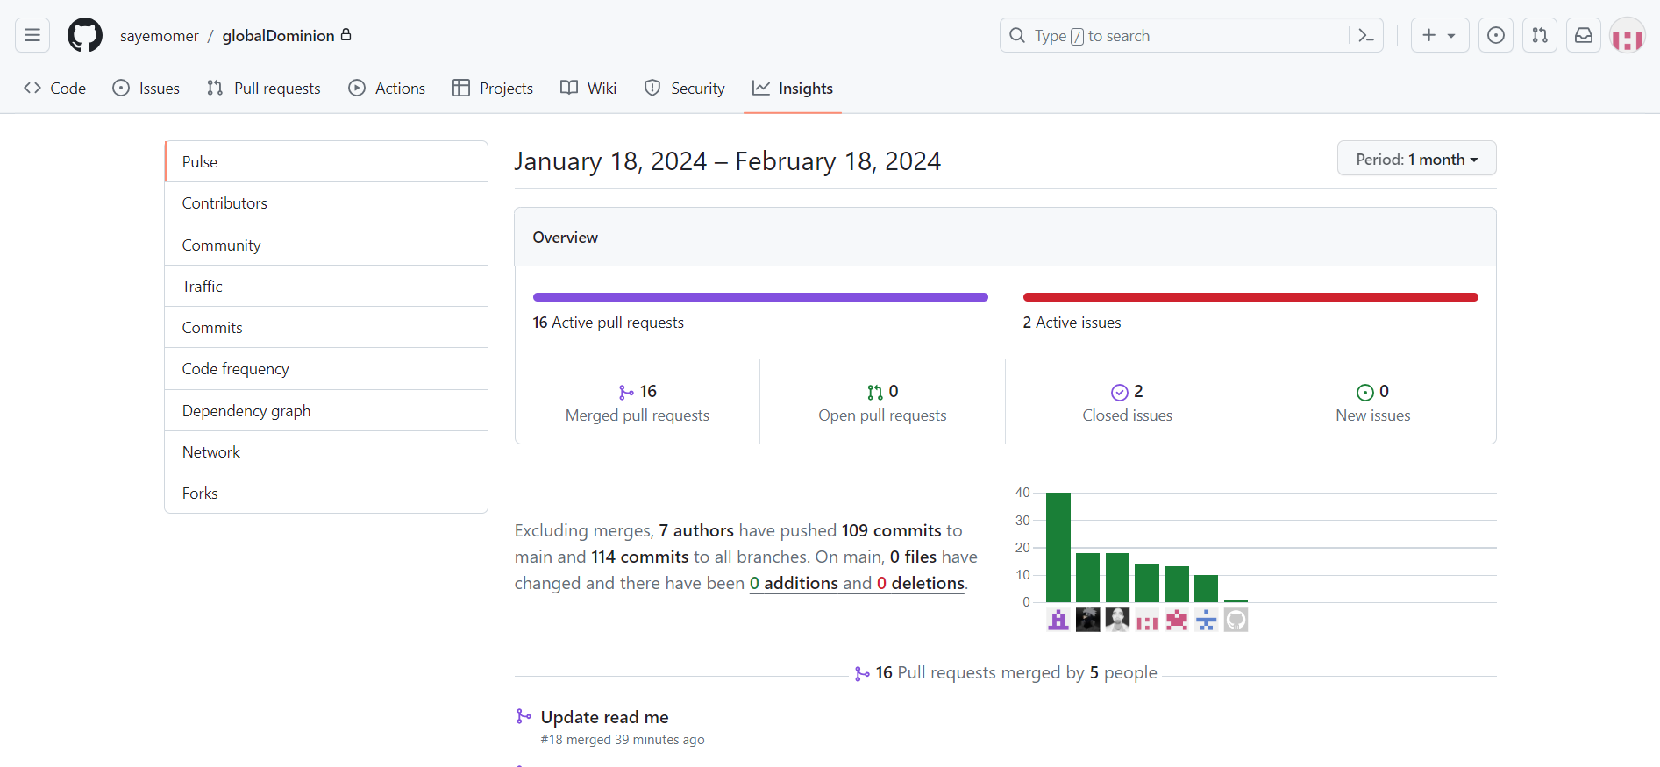

Slide 62
JavaDoc Pictures

Slide 63
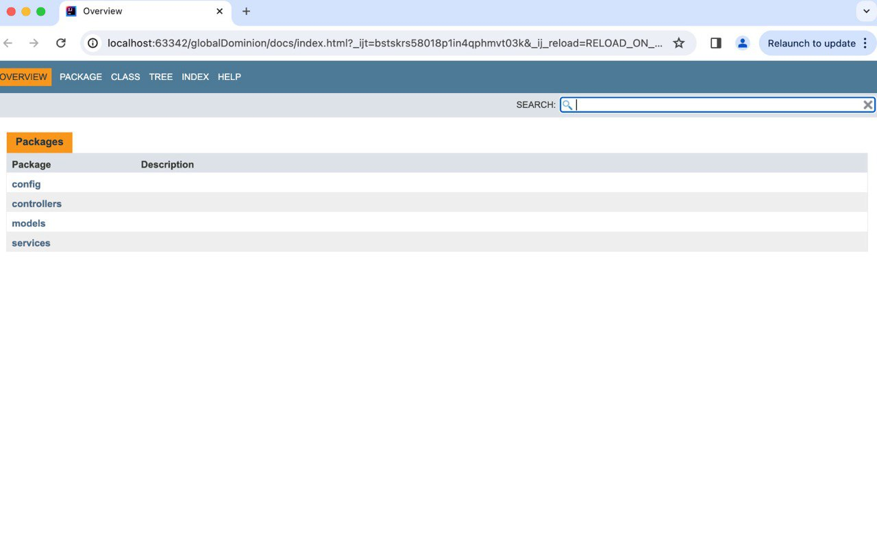

Slide 64
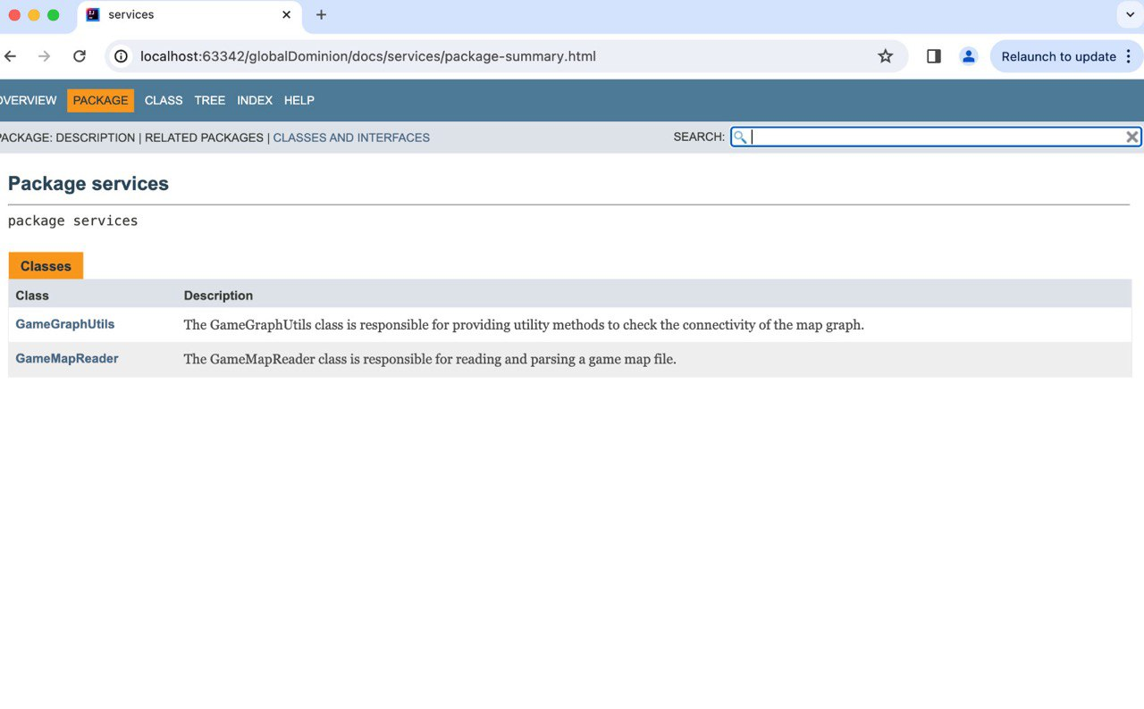

Slide 65
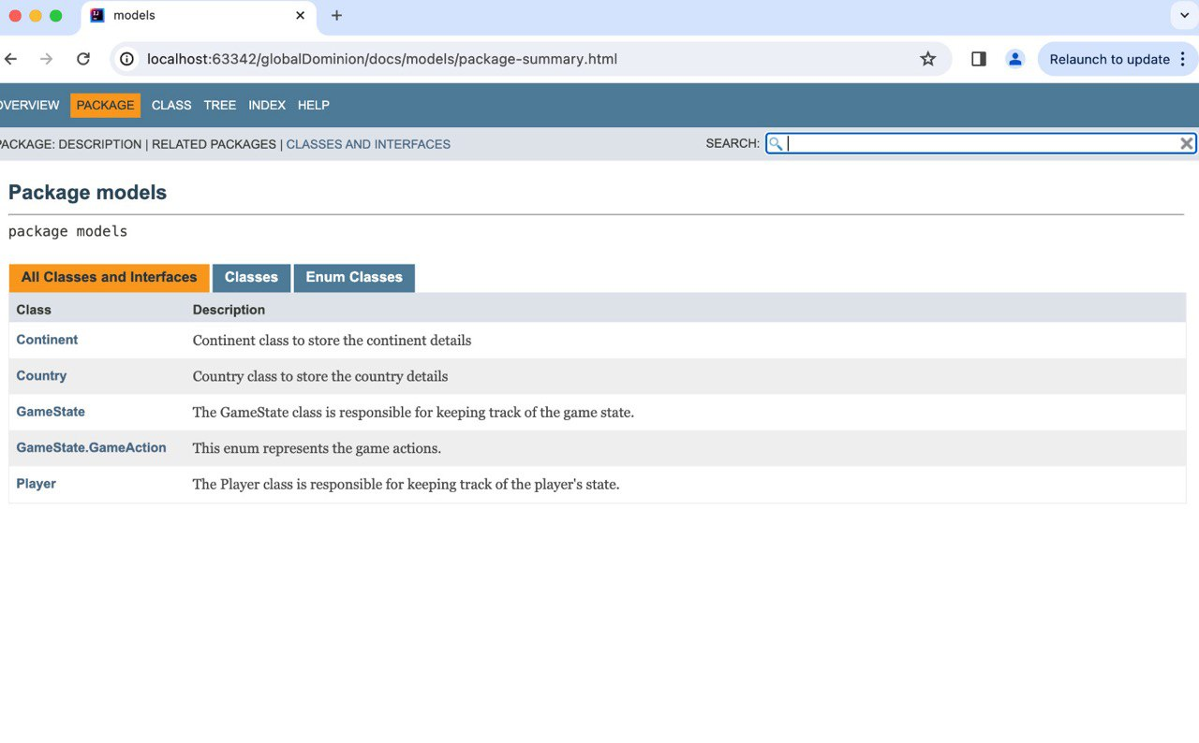

Slide 66
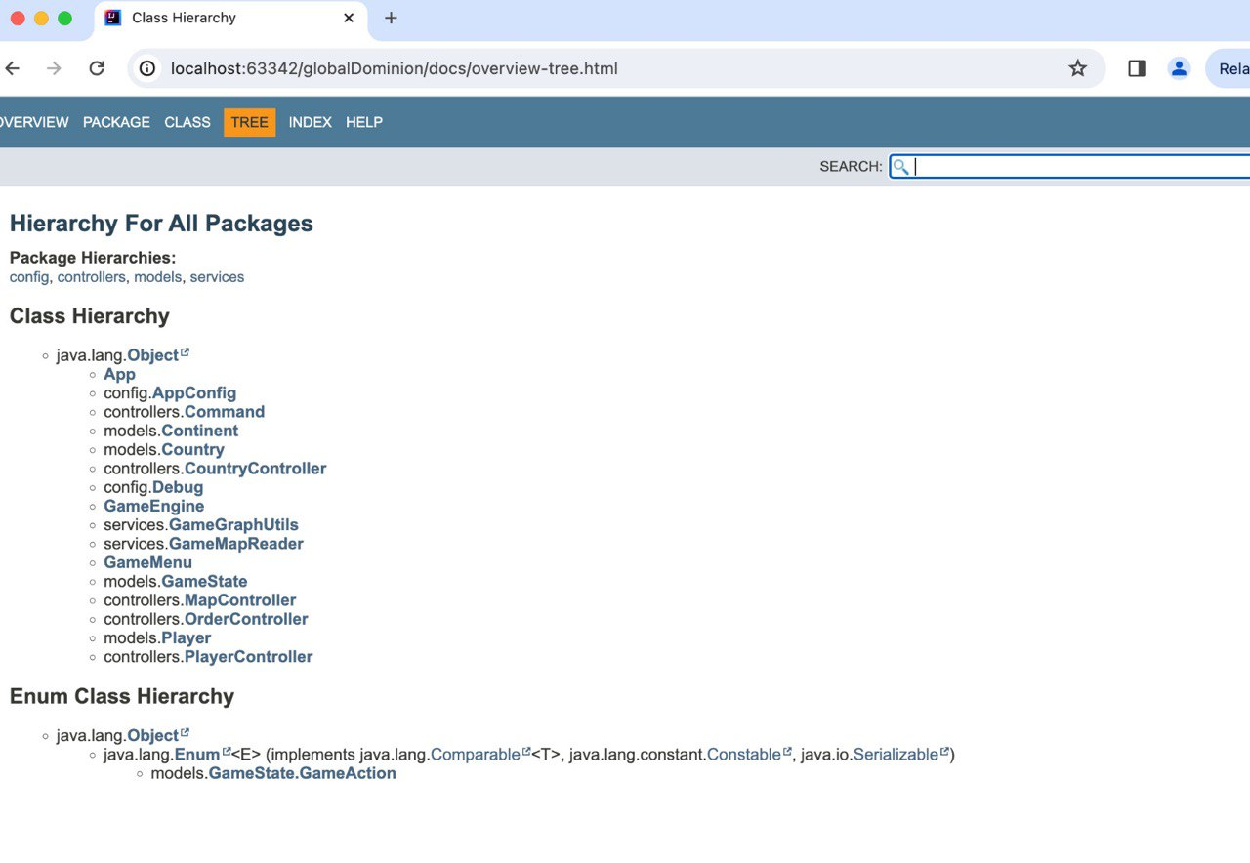

Slide 67
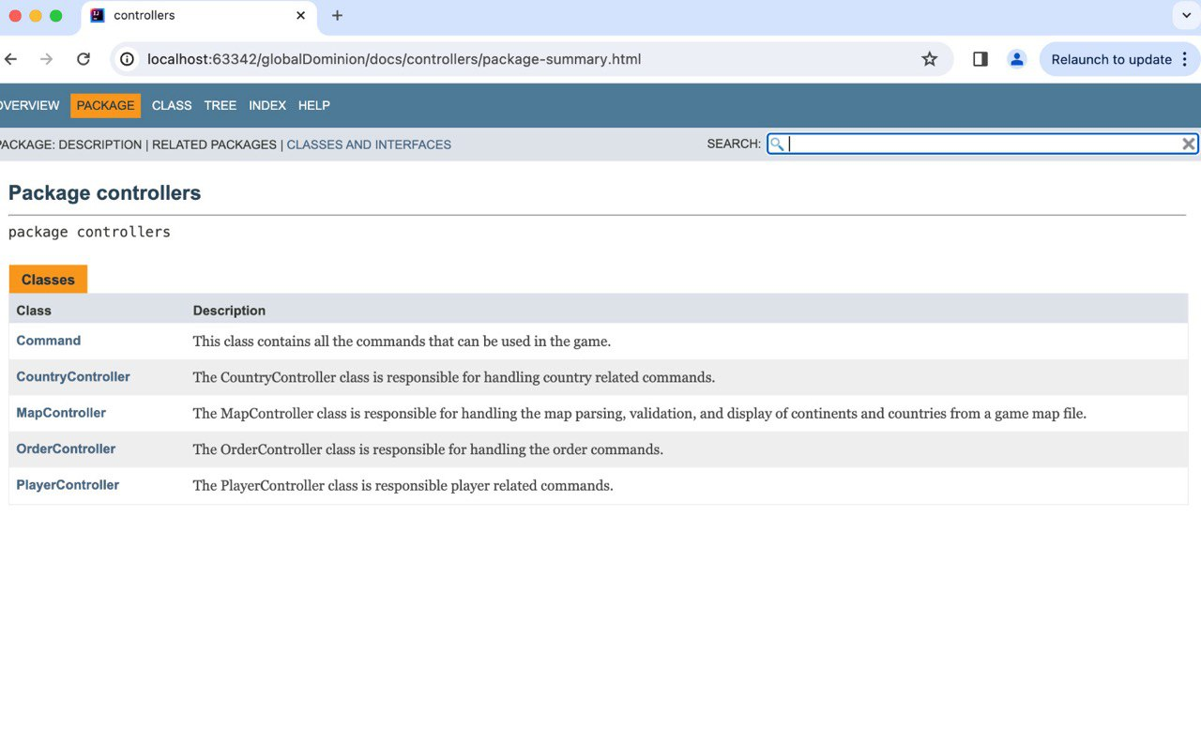

Slide 68
Thank you

